Slide 1
Properties of matter
Topic 1

Slide 2
Objectives
Define and identify pure and impure substances.
Explain the differences in properties of pure and impure substances.
Write a method to separate a complex mixture of substances.

Slide 3
Key Classifications
Atom
Molecule
Molecular element
Molecular compound
Ionic compound
Pure/impure
Mixture
Homogenous/Heterogenous materials
Polymer

Slide 4
Properties of Matter
Pearson Ch 1.1-1.3
Lucarelli Ch 3

Slide 5
Homogeneous materials
Have uniform composition throughout
Includes all pure substances (elements and compounds) and some mixtures
The only kind of mixture that is homogeneous is a solution, eg: salt water

Slide 6
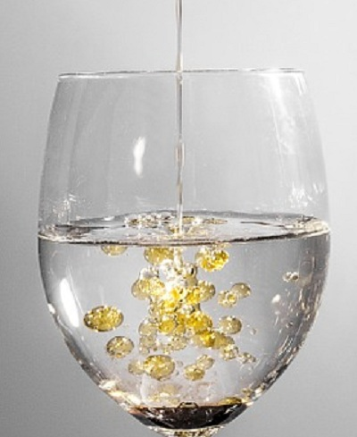
Heterogeneous materials
Heterogeneous materials are non-uniform – you can see differences from one section to another
The constituents are physically separated, eg: in a different phase
Examples include:
Granite (mixture of different mineral grains)
Milk (fat globules suspended in water)
Toothpaste (solid particles suspended in liquid)

Slide 7
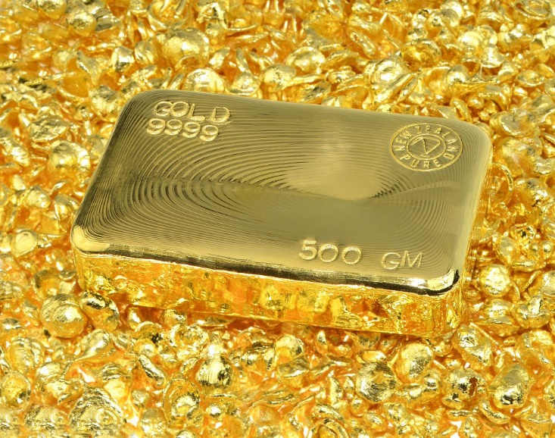
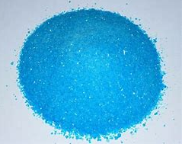
Pure substances
Have a fixed or constant composition
Cannot be separated by physical means
Have well defined physical properties, eg:
melting point
boiling point
hardness
density
colour
Have constant chemical properties
copper (II) sulfate

Slide 8
Mixtures
Contain two or more different substances, in proportions that can vary
Properties vary with composition, depend on the identity and amounts of constituents
Properties of individual constituents can be used to separate the mixture

Slide 9
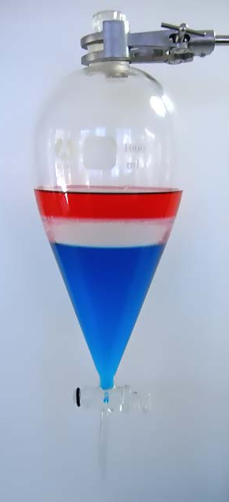
Separating Mixtures
Mixtures can be separated by any means that makes use of the different physical properties (and states) of its constituents.
The properties of the components of a mixture determine the best separation method.

Slide 10
Methods of separation
Find out how each of these methods can be used to separate a mixture.
Give an example of a mixture that could be separated by each method.
Physical properties
States
Lucarelli Chapter 3
Pearson Chapter 1.3
Sieving
Filtration and vacuum filtration
Decanting
Separation funnel
Distillation
Fractional distillation
Electrostatic attraction
Magnetic susceptibility
Evaporation
Crystallisation
If finished: Start Set 4 of Lucarelli on page 26
STAWA Set 4 Question 4

Slide 11
Writing Methods
Use STAWA Set 4 Q4 to practice writing methods for separation.
A good method:
Is a numbered list of instructions, not a description or explanation.
Makes clear the order in which things happen.
States what equipment is used at each stage.
Gives quantities where required.
Makes sense to another human!

